Slide 1



QVI Customer Behavior Sales Analysis
View in Power BI
Last data refresh:
7/27/2024 10:33:08 AM UTC
Downloaded at:
7/27/2024 10:41:16 AM UTC

Slide 2
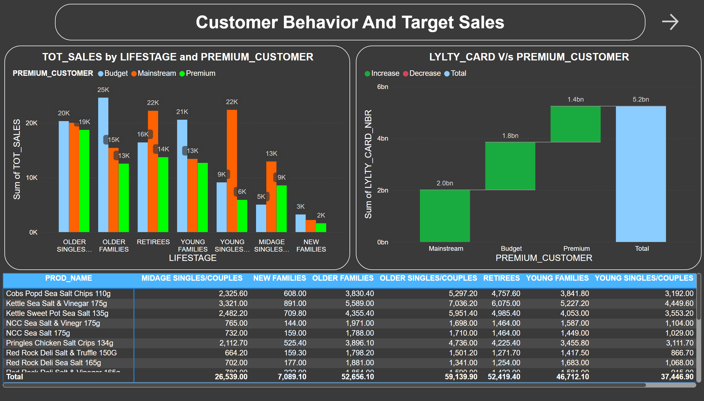
Customer Behavior And Target Sales
Notes:
LYLTY_CARD V/s PREMIUM_CUSTOMER
No alt text provided
pivotTable
No alt text provided
TOT_SALES by LIFESTAGE and PREMIUM_CUSTOMER
No alt text provided
textbox
No alt text provided
actionButton
No alt text provided

Slide 3
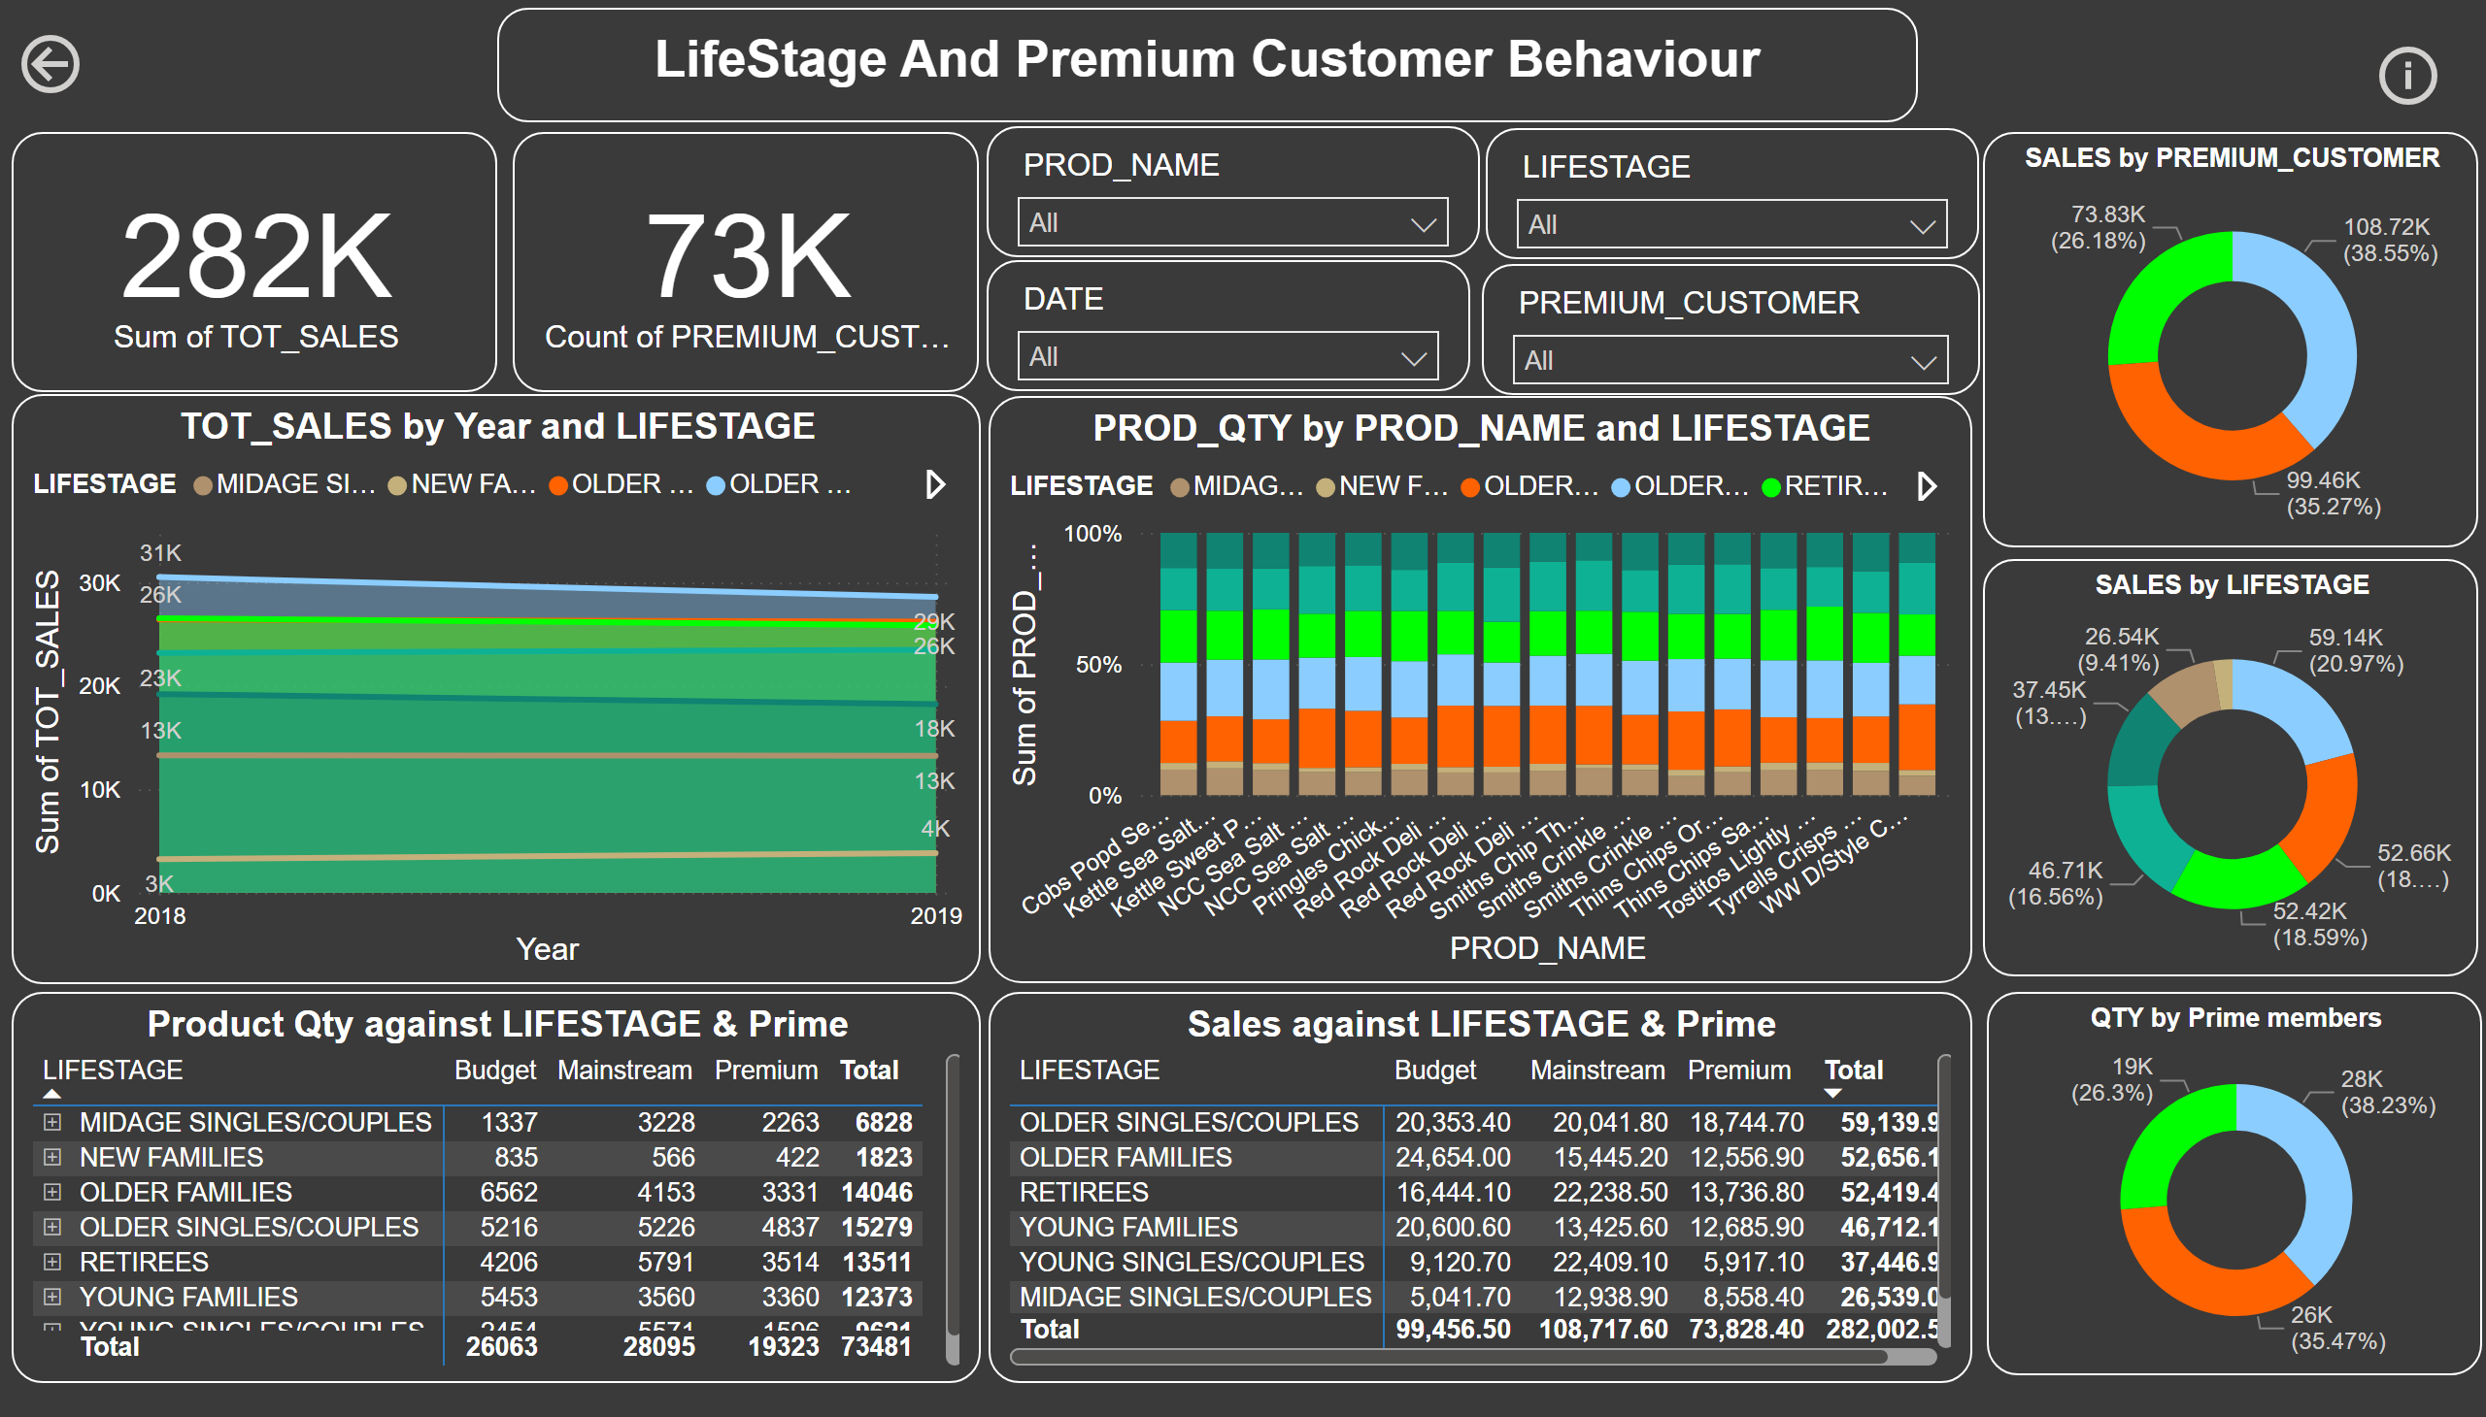
Life-Stage And Premium Customer Behavior
Notes:
TOT_SALES by Year and LIFESTAGE
No alt text provided
PROD_QTY by PROD_NAME and LIFESTAGE
No alt text provided
Product Qty against LIFESTAGE & Prime
No alt text provided
Sales against LIFESTAGE & Prime
No alt text provided
card
No alt text provided
card
No alt text provided
SALES by PREMIUM_CUSTOMER
No alt text provided
SALES by LIFESTAGE
No alt text provided
QTY by Prime members
No alt text provided
slicer
No alt text provided
slicer
No alt text provided
actionButton
No alt text provided
slicer
No alt text provided
slicer
No alt text provided
textbox
No alt text provided
actionButton
No alt text provided

